Slide 1
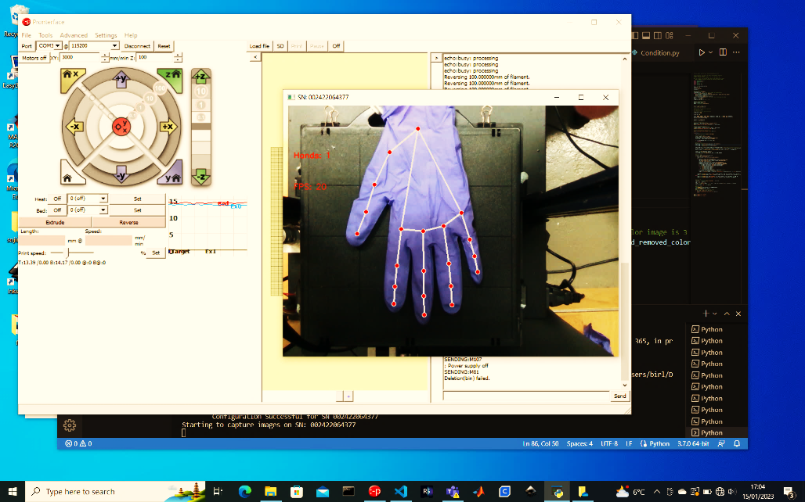

Slide 2
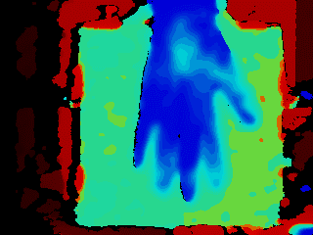
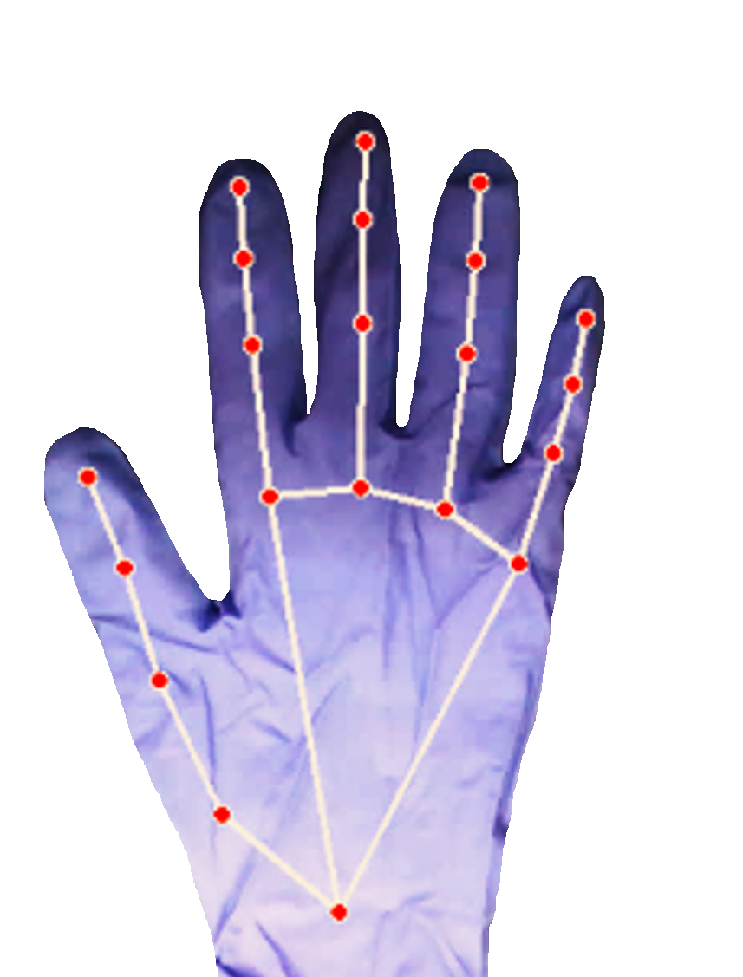

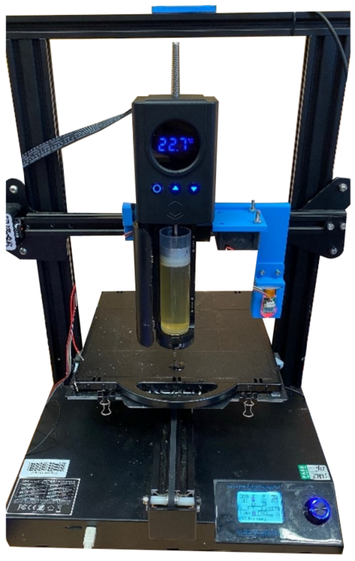
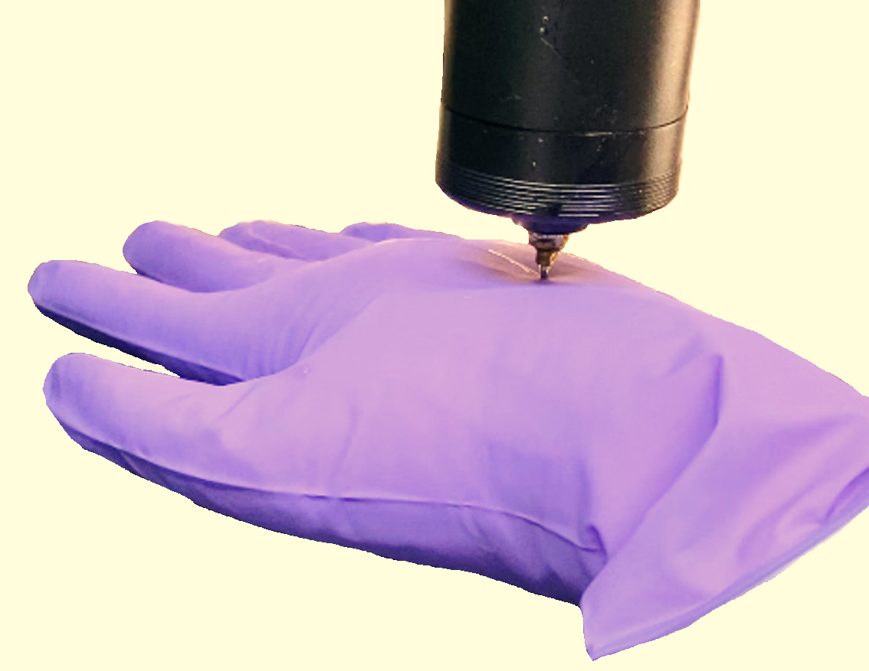
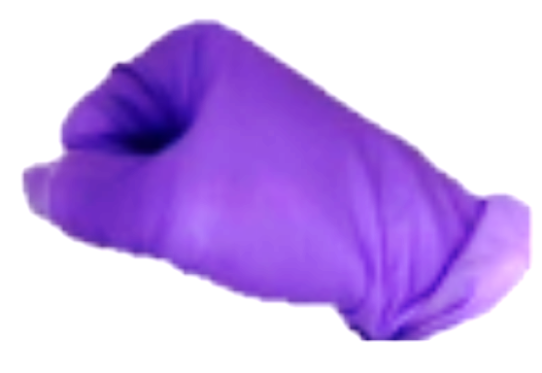
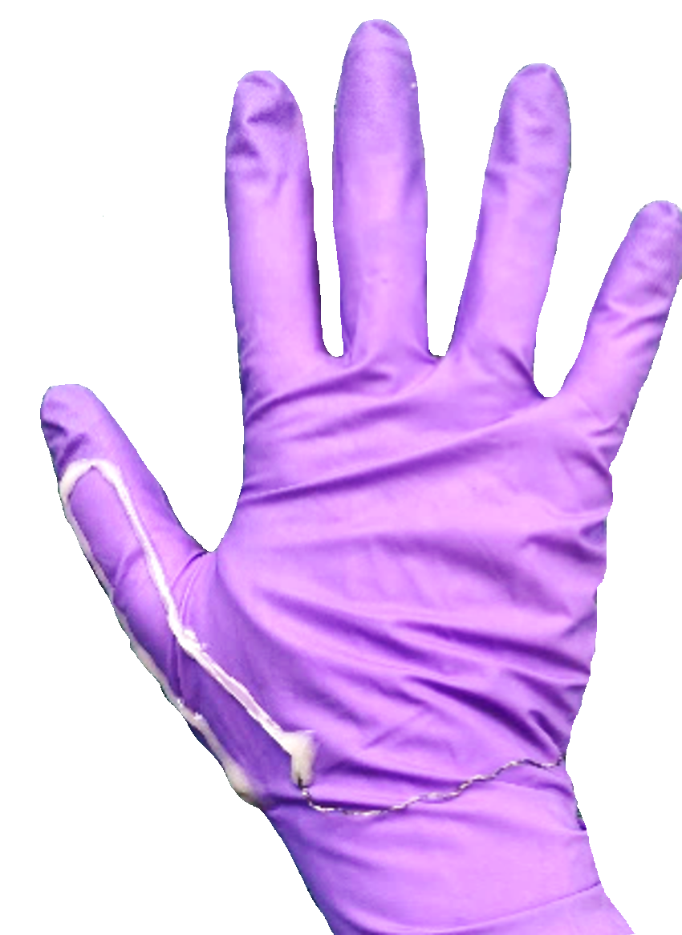
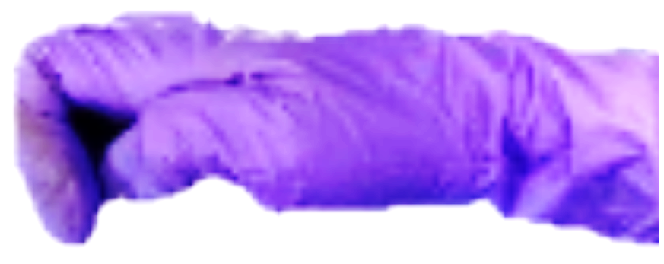
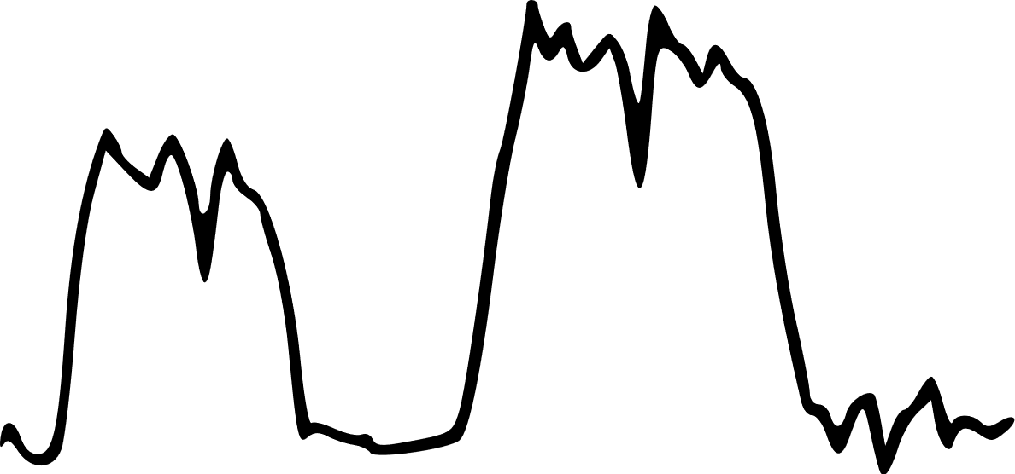
Figure1 Overview
Hand Scan
Optimization
Closed-loop
Printing
3D Printer
Evaluation
Printed Sensor
Fig.1 Overview of this study

Slide 3
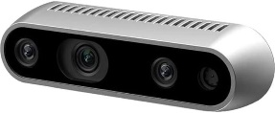
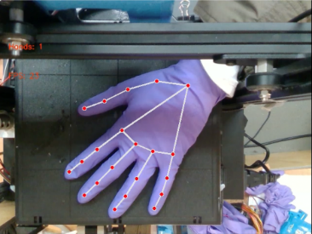
Depth Camera
Bayesian
Optimization
Hand Scan
Depth Camera
Sensorized
Gelatin Hydrogel
Pose 1
Pose 2
3D Printer
Heated Nozzle
Evaluation
Closed-loop
Sensor Printing
Printed Sensor
Camera vision
Heated nozzle
& Hydrogel

Slide 4
